Slide 1

sahayak
Made by :- j coders
Sk. Arshad akhtar
Sumeet nayak
Nishikanta ray

Slide 2
Requirements
Network
Css, html , js , php
People's participation

Slide 3
Covid 19 problem
India, with a population of over 1.3 billion, has seen troublesome growth in covid 19 cases in the past two months . When people are quarantined , they need to be taken care of and keeping them healthy is the most important .The problem arises with tackling the situation accordingly as It is unable to provide access to food or medicinal supplies to a large number of people . This is where Sahayak lends its helping hand .

Slide 4
What it is :-
Sahayak is basically a webapp that brings useless food to use of welfare, and also eases the access of food items and medicinal supply. It is built on js, css, html as a website for anyone to access to donate food or search for grocery or medcines .
It works 24*7 , and is totally easy to access for a comman man. Just search where the item, get its location and then go purchase it.

Slide 5
How it works :-
Sahayak mainly helps in three ways:- Finding medicines / Finding grocery / Food Donations.
Finding Items:- During first step the shopkeepers having the medicines/grocery need to enlist it on the webapp with required data(such as expiry date/manufactured date and cost). As the medicines/food items are sold or they are refurbished, the owners need to update the data as soon as possible. When a person would need any medcinal/food supply, he would just need to put in a search query for it and then the webapp will show the nearest shop having that item.

Slide 6
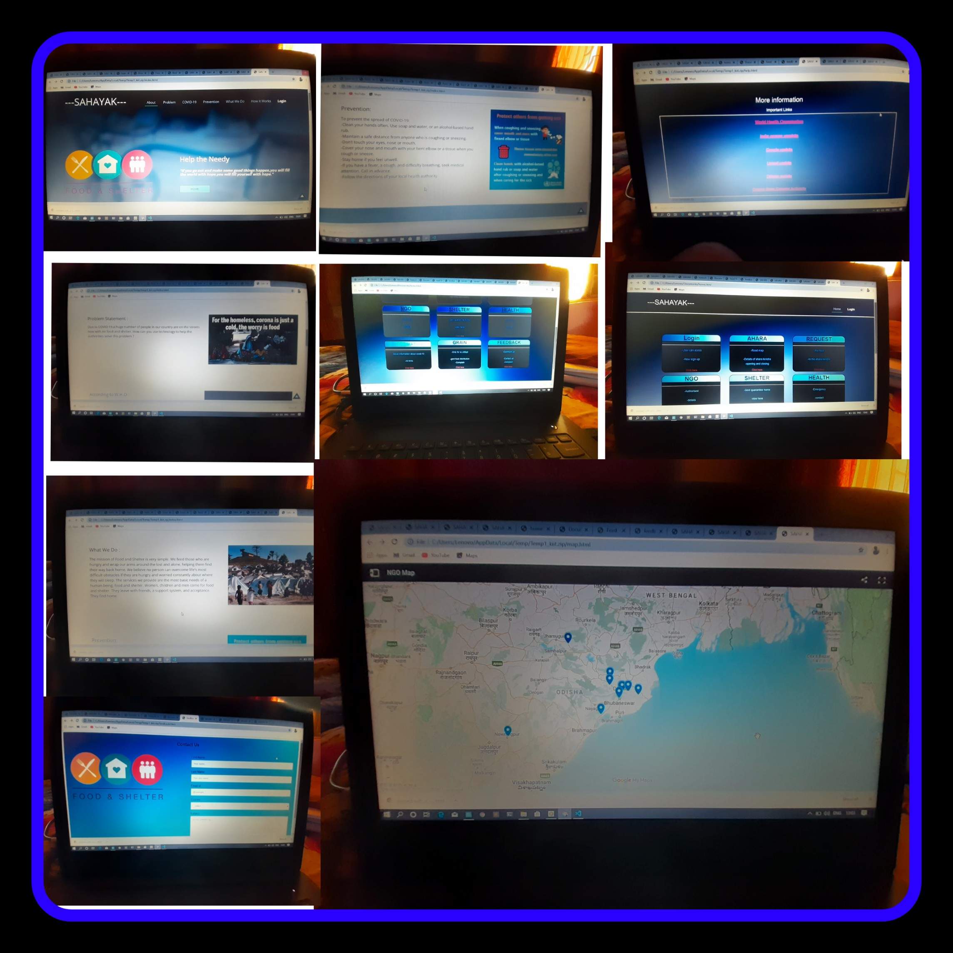
Sahayak website

Slide 7
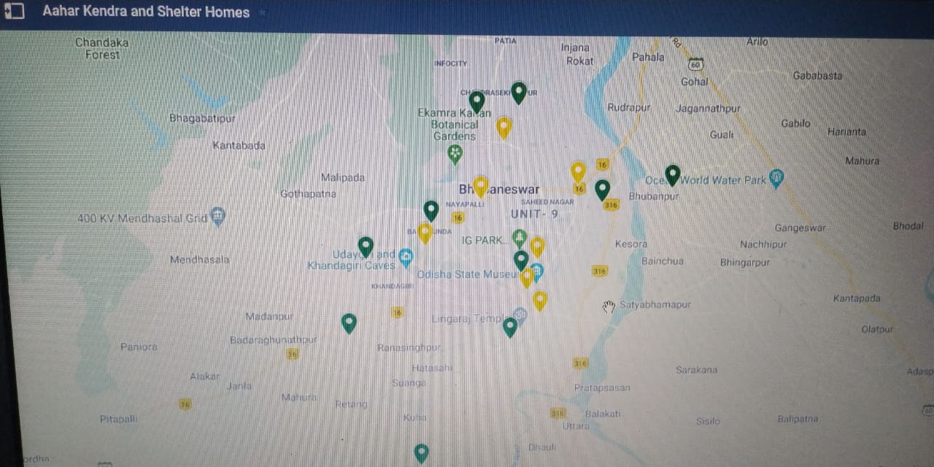
Maps showing ngos and centres where food is available

Slide 8
Buisness model
Target audience are poor persons living on footpath or people having small income or daily wages . Due to covid19 these persons cant work and unable to get even 2 meals per day.
Plan is to provide this website to public , where the govt and ngos can directly locate and help the needy persons .
People can easily locate areas through the provided maps . Govt and people directly interact , which eases distribution of help .

Slide 9
App maintainance:-
Sahayak is a simple webapp and easy to use webapp. It doesn't need much maintaince. Maintaining an app costs about 15% of revenue generated from sales of that app. Since this app is in its basic development stage, the cost needed to maintain it is negligible.

Slide 10
Aim of sahayak:-
Provide food to the needy and unprivilaged.
Help people find their requirements easily.
People can easily find medicinal supply during and emergency situation.
Efficiently distrubutes workload on shops during pandemic like situations.
People wouldn't need to panic or pick trouble ever for finding food and medicines.

Slide 11
1st implementation:-
It would first be implemented on a small area and people living in it(the common mass). To check the efficiency of task performed and results obtained. Then it will move on to a bigger area and benefiting more and more people.

Slide 12

Digital Communications
Access Sahayak
Call @123456
Donate personally

Slide 13

Thank You
NISHIKANTARAY1@GMAIL.COM
Akhtarskarshad2@gmail.com
Sumeetnaikcs@gmail.com

